Slide 1
Jobs Info

Slide 2
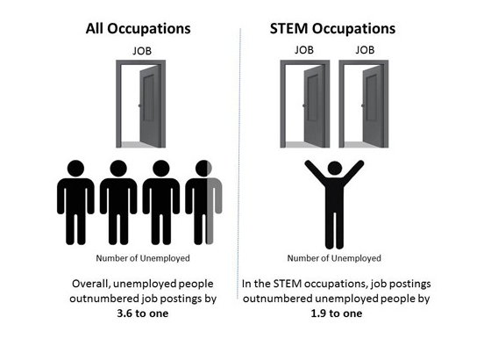
STEM Help Wanted

Slide 3
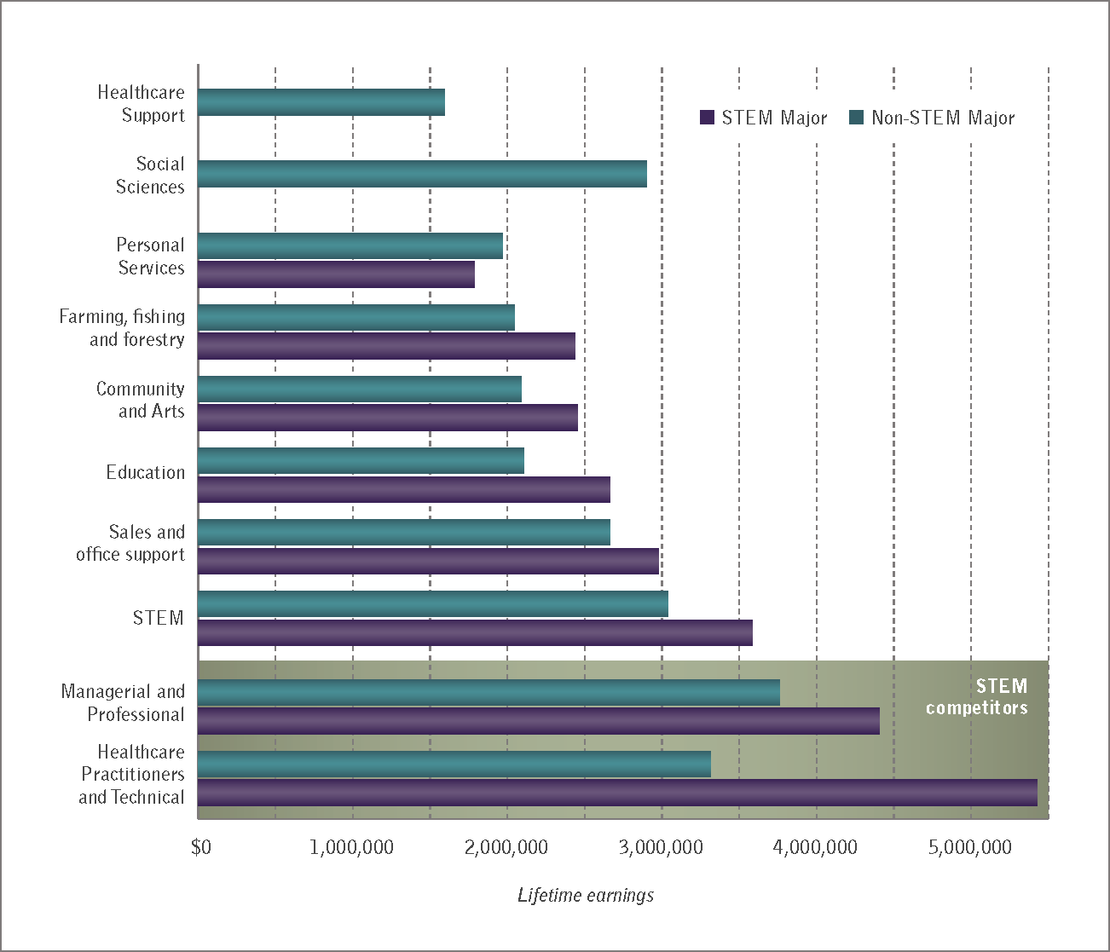
STEM majors earn more, in any field they choose

Slide 4
U.S. Workforce through 2020
Source: Jobs data and mean annual wages are from the Bureau of Labor Statistics (BLS), Employment Projections 2010-2020, available at http://www.bls.gov/emp

Slide 5
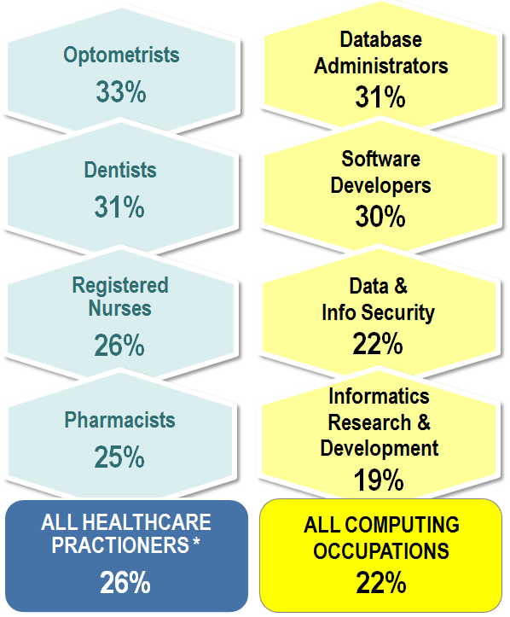
U.S. Employment through 2020 How Computing Stacks Up To Healthcare
22% job growth rate
in computing jobs, as comparable to healthcare job growth rates 2010-2020.
51,000 projected shortfall
in qualified health IT workers 2011-2015.
90% of physicians
to use electronic health records by 2019 as a result of the federal HITECH Act of 2009.
Growth Rates
* Healthcare practitioners and technicians
Sources: Bureau of Labor Statistics (BLS), Employment Projections 2010-2020, available at http://www.bls.gov/emp/. U.S. Department of Health and Human Services (HHS), HITECH Programs, http://www.healthit.gov. Congressional Budget Office, Analysis of HITECH Act of 2009.

Slide 6
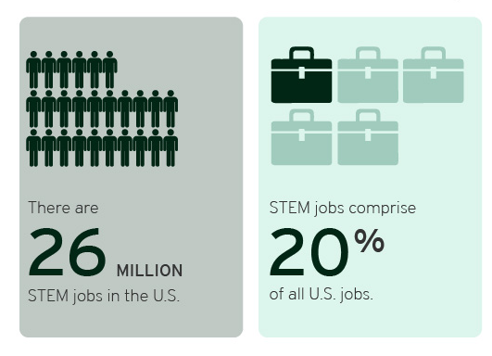
http://www.brookings.edu/research/interactives/2013/the-hidden-stem-economy

Slide 7
Education Info

Slide 8
The majority of college students and parents believe that preparing students for careers in STEM should be a priority for K–12 schools in the U.S.; however, only half believe it actually is a top priority in schools.
The State of STEM Education in the U.S.
% agree among students and parents
Female students are more likely than their male counterparts to say that preparing students for STEM should be a top priority in K–12 schools (92% vs. 84%) — another indication of how important K–12 education is for girls.
STEM College Students
Parents of K–12 Students
While parents may feel that K–12 schools are not meeting expectations when it comes to STEM, many are not extremely willing to spend their own money helping their children be successful in their math and science classes (24% extremely willing vs. 37% very willing, 34% somewhat willing, and 5% not at all willing).
________
____
__
76% of parents feel that the U.S. is doing a poor job of teaching STEM compared to other countries.

Slide 9
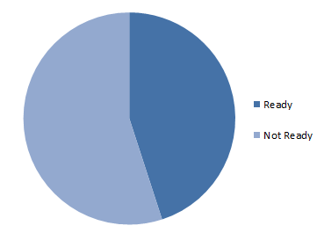
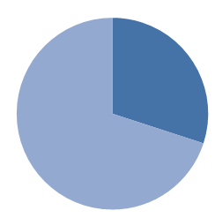
Percentage of 2011 high school seniors ready for college-level courses in math and science
Math
Science
45%
30%
http://changetheequation.org/stemdemand

Slide 10
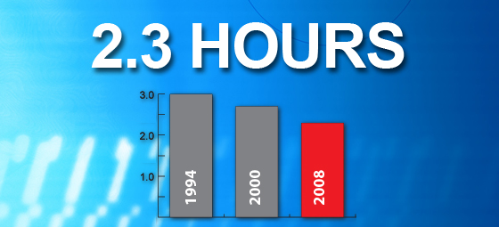
STEMtistic: Got Science?
U.S. elementary schools devote and average of 2.3 hours per week to science, a decline of 43 minutes since 1994.
Notes:
Source: U.S. Department of Education, National Center for Education Statistics, Schools and Staffing Survey (SASS), "Public Teacher Data File," 1987-88, 1990-91, 1993-94, 1999-2000, 2003-04, and 2007-08; "Public School Data File," 1987-88, 1990-91, 1993-94, 1999-2000, 2003-04, and 2007-08; "Charter Teacher Data File," 1999-2000; and "Charter School Data File," 1999-2000. Retrieved 7/27/2011 from http://nces.ed.gov/surveys/sass/tables/sass0708_005_t1n.asp.

Slide 11
So why do parents feel that STEM education should be a priority? About half say it’s to ensure that the U.S. remains competitive in the global marketplace and also to produce the next generation of innovators. Preparing students to have well-paying and fulfilling careers are less important.
Parents: Why Should Preparing Students for STEM Careers Be a Top Priority for Schools in the U.S.?
Up to 3 responses selected
Dads are more likely than moms to list this is a reason (62% vs. 47% moms).
Parents in high-income households are least likely to give enabling students to have well-paying careers as a reason (29% in $75K+ households vs. 37% in <$35K, 42% $35–49.9K, 46% in $50–74.9K).
Moms are more likely than dads to list this as a reason (36% vs. 22% dads).

Slide 13
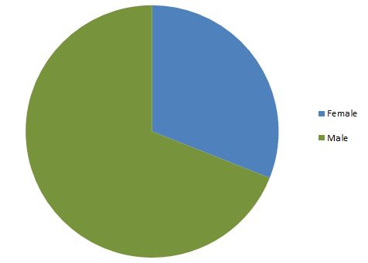
http://changetheequation.org/http%3A/%252Fchangetheequation.org/stemtistic-vs-women-1
Only 31% of STEM degrees are awarded to women
31% Female
69% Male

